Slide 1
Small electric vehicles

Slide 2
What is it?
Small electric vehicle is a one-person vehicle that is driven by one, or more, electric engines.

Slide 3
Categories
Electric scooters and bikes
Hoverboards
Electric skateboards
Segways

Slide 4
Advantages and disadvantages of small eletric vehicles
+ | -
Environment friendly | Weight
Lack of noise pollution | Batteries
Charging convenience | Maintenance

Slide 5
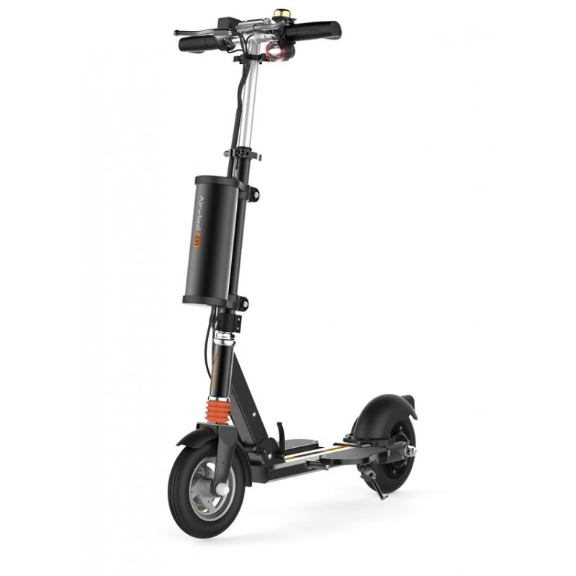
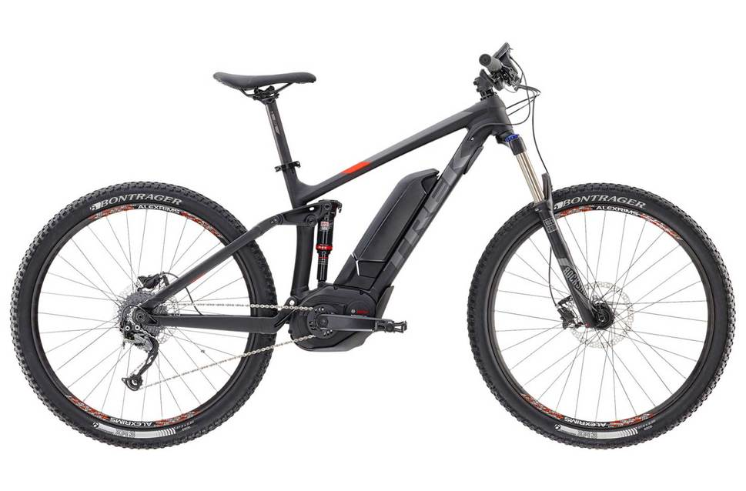
Electric scooters and bikes

Slide 6
Advantages and disadvantages
+ | -
Faster than conventional version | Fragility
Stability | Price
Hybrid drive | Tires

Slide 7
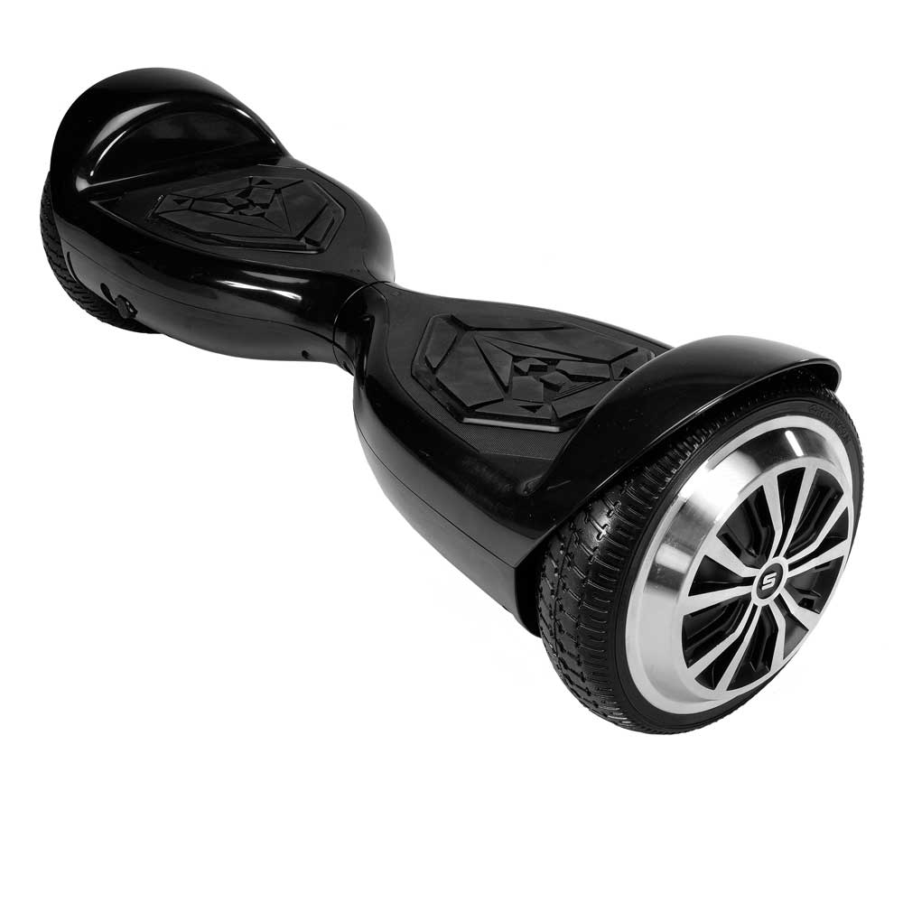
Hoverboards

Slide 8
Advantages and disadvantages
+ | -
Free-hand way to steer | Low maximum speed
Pocket size | unstable
Relatively cheap | Not adapted to offroad

Slide 9
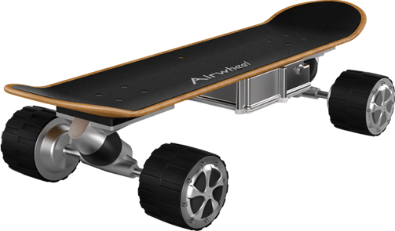
Electrics skateboards

Slide 10
Advantages and disadvantages
+ | -
Pocket size | Small wheels
Easy battery exchange | Hard to learn
 | Manoeuvrability

Slide 11
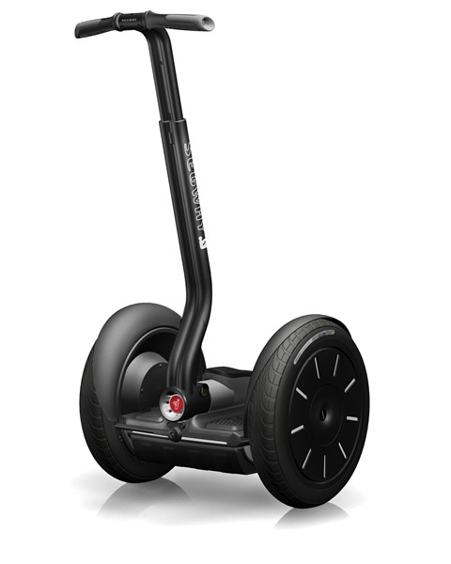
Segways

Slide 12
Advantages and disadvantages
+ | -
Easy to learn | No way to move when batteries drain out
Comprehensive (używane przez policję, przewodników itp.) | Expensive (the most of SEV)
manoeuvrable | Big size

Slide 13
Sources
http://airwheelineurope.com/airwheel/37-electric-scooter-airwheel-z3t.html
http://electricbikeindia.weebly.com
https://static.evanscycles.com/production/bikes/electric-bikes/product-image/969-638/trek-powerfly-fs-5-2017-electric-mountain-bike-black-orange-EV282570-8520-1.jpg
https://gizmodo.com/what-s-wrong-with-electric-bicycles-1702986234
https://www.smartwheel.ca/assets/images/133942.jpg
https://swagtron.com/wp-content/uploads/swagtron_t5_black_front_bumper_perspective.jpg

